Slide 1
Introduction
With streaming giants investing in original content, our company is stepping into the movie production space. But what kind of films should we produce to succeed at the box office?
This project dives into what’s working at the box office and what critics are saying so we can make smart, evidence-backed decisions for our studio launch.

Slide 2
Data Sources
• Box Office Data: Sourced from The Numbers, covering revenue performance across studios and movies.
• Critic Reviews Data: From Rotten Tomatoes, giving insights into sentiment and critical perception over time.
Cleaned, filtered, and merged where necessary.
Total records analyzed: 700+ movies (2010–2018) for revenue and 30,000+ reviews (1950–2018) for critics.

Slide 3
Methodology
• Data wrangling in Python using Pandas & Seaborn.
• Visualizations built using Tableau for deeper storytelling.
Focus Areas:
- Revenue trends over time
- Studio and movie performance
- Critic sentiment and influence
- Rating patterns and audience reception

Slide 4
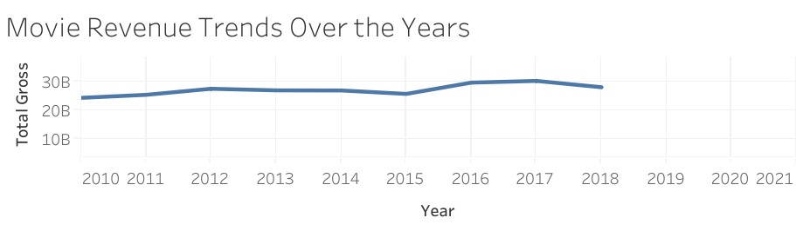
Movie Revenue Trends Over the Years
Total movie revenue held strong between 2010 and 2018, peaking in 2016.
This indicates consistent consumer interest — a positive signal for new studios entering the market.

Slide 5
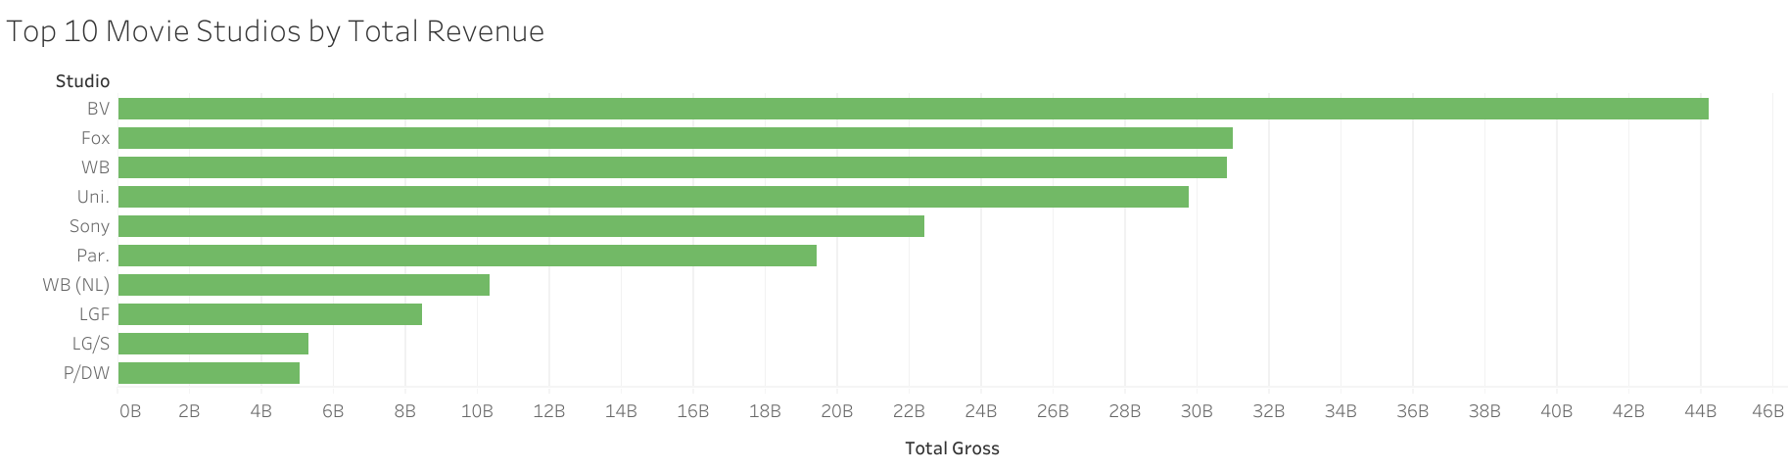
Top-Grossing Studios
Studios like Disney and Warner Bros consistently lead in total revenue.
Brand recognition and established franchises play a key role.
Our studio should consider co-productions or partnerships to build credibility.

Slide 6
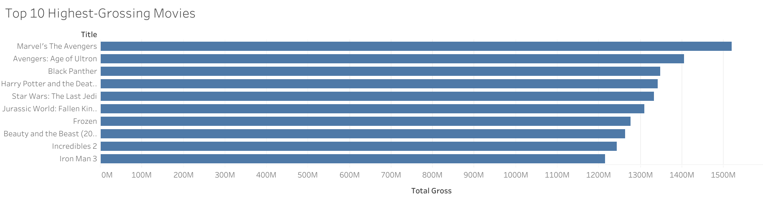
Top 10 Highest-Grossing Movies
Franchise-based, action-adventure films dominate the charts.
These include superhero and epic-style storytelling with sequel potential.
Recommendation: Focus on high-impact, blockbuster genres.

Slide 7
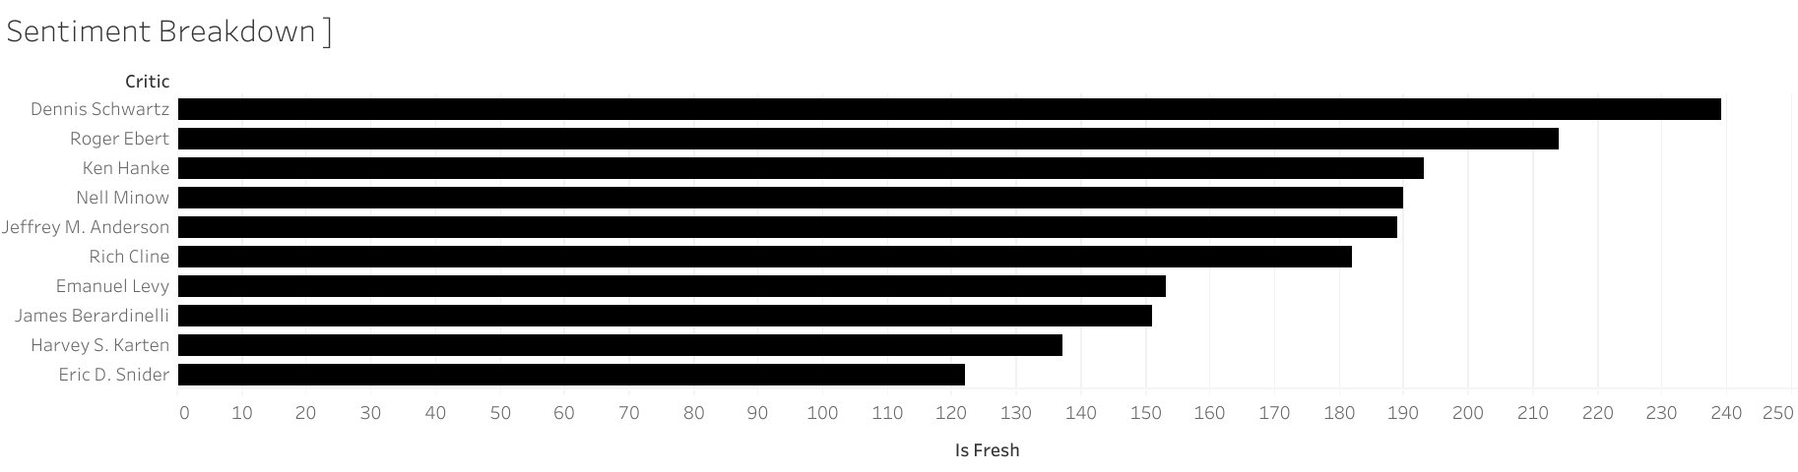
Critical Sentiment Breakdown
Top critics like Dennis Schwartz and Roger Ebert influence public opinion.
While reviews tend to lean positive, consistent quality storytelling is essential to earn their approval.

Slide 8
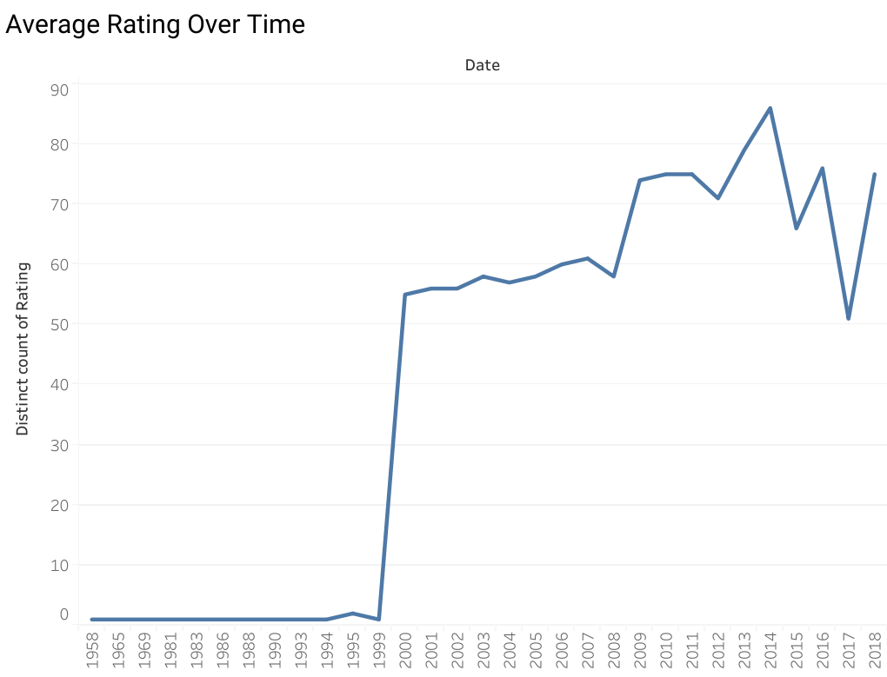
Average Rating Over Time
Critic ratings have shown a gradual upward trend since the early 2000s.
This suggests rising expectations — our films must maintain a high standard to succeed.

Slide 9
Business Recommendations
• Genre Focus: Prioritize action, adventure, and sequel-friendly films.
• Studio Strategy: Use recognizable talent or IP to gain market trust.
• Critic Engagement: Involve top critics early to build anticipation.
• Trend Monitoring: Watch sentiment and rating data post-launch.

Slide 10
Conclusion
Data doesn’t just tell us what’s popular — it reveals what’s possible.
Armed with these insights, we can make informed decisions and avoid costly flops.
Prepared by: Michael Kamuya Makao
Email: michael.michael@student.moringaschool.com

